Slide 1
LUNCH BOX
Pack a punch for lunch – tasty meals in minutes

Slide 2
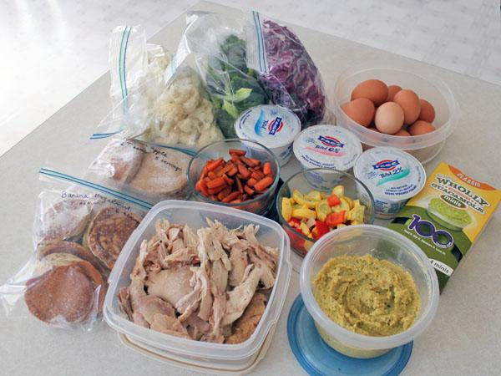
WHAT WE ARE DOING
LunchBox App:
Creating tasty step by step nutritional food from ingredients already in your fridge

Slide 3
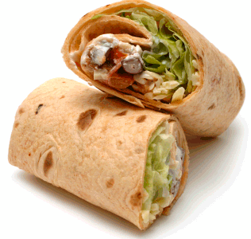
WHERE WE ARE
Launching 6th June 2016

Slide 4

TARGET MARKET
TARGET MARKET
Busy Mums
Parents who are concerned with their children's nutrition
20-30 year olds with active lifestyles

Slide 5
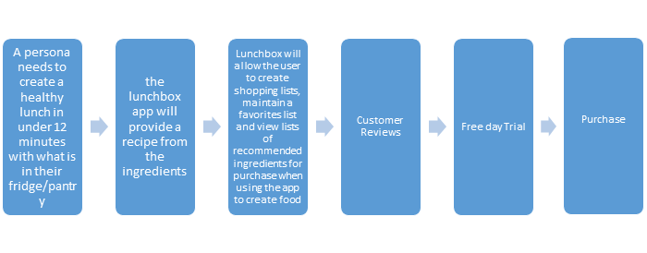
BUYER’S JOURNEY
Awareness Stage
Consideration Stage
Decision Stage

Slide 6

UNIQUE SELLING POINT
Make a delicious, nutritious lunch in less than 12 minutes from food already in your fridge.

Slide 7
Weakness:
Early stages with limited resources and short deadlines
Strengths:
Niche market with clear market strategy
SWOT
Analysis
Opportunities:
Partnerships and additional revenue from advertising and data analysis
Threats:
Open competition, funding replication of app.

Slide 8
CHANNEL STRATEGY

Slide 9

OUR MARKETING STRATEGY
Targeting audiences through social media platforms
Highly optimised Website & active Blog
Regular feature rich Newsletters

Slide 10
FACEBOOK
LUNCHBOX ON SOCIAL MEDIA
YOUTUBE
PINTEREST
GOOGLE ADWORDS & PPC

Slide 11
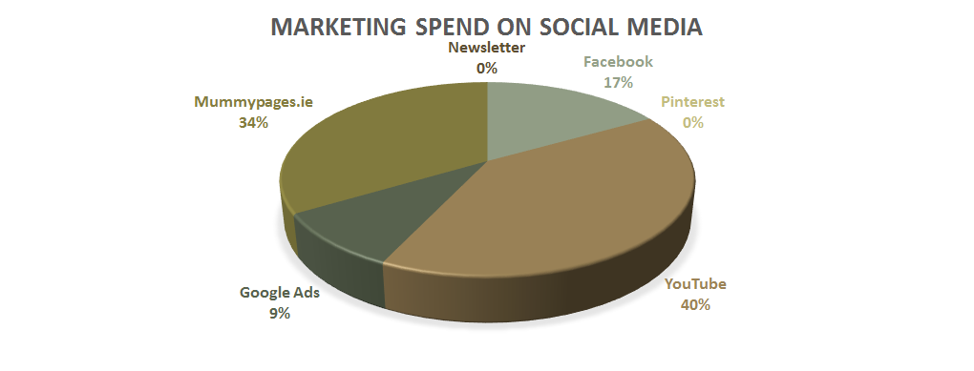

Slide 12
THE WEBSITE
How we are going to use it
Construction
Landing Pages
Measurement KPI
  Direct visitors to download our app
  Gather Newsletter Subscribers
  Provide a content rich Multimedia Blog/News section
  Built responsively with Twitter Bootstrap
  Wordpress for the blog section
  SEO Optimised, lightweight & Fast
  SSL cert for trust
  HOME: App download links & Newsletter Signup
  LEAD GENERATION: Detailed Newsletter signup form
  CLICK THROUGH: Prominent App download links
  Google Analytics & Goals

Slide 13

EMAIL NEWSLETTER
Use the MailChimp platform
Ask for First Name & Email
Regular rich double opt in content
Highly shareable content
Image heavy, low on text
Prominent App download links
High Open and Click rates

Slide 14

Google AdWords
Specific, Measureable, Achievable, Realistic, Time Scale (SMART) Campaign
Highly targeted Ads
Low number of specific keywords/phrases
Multiple campaigns with different website landing pages
Mums targeted
General targeting

Slide 15
METRICS & KPI’s
Website
Facebook
youTube
Pinterest
  Google Analytics
  Analytics Goals
  App Download Goal
  Newsletter Signup Goal
  Social Share Goals
  Contact & Create Account Goals
  Facebook Insights
  Facebook Ad Reports
  Facebook Demographics
  Website pixel analytics
  youTube Analytics
  Subscribers
  Video views
  Click throughs to website
  Engagement & Demographics
  youTube Monetisation
  Pinterest Analytics
  Daily Impressions & Views
  Website Pins & Repins
  Engagement
  Demographics

Slide 16

Leon Quinn
Keith Brennan
Derek O’Flaherty
Niamh Monaghan
Mary Hurley

