Slide 1
The Storyboard
Less a map, more a guide; a starting point, not a destination.

Slide 2
The Storyboard
The Storyboard was envisaged as a starting place, rather than a destination. A guide to go off road rather than a route map to follow.
We rendered it in hype low-fi. Pen and paper. Working on the basis that we’d be happier improvising, improving, altering and adapting a storyboard that already looked rough, rather than feeling tied down by a version that was high fidelity, and had a large amount of work put in.
The storyboard doesn’t reflect the final look, feel and structure of the prototype, though most of what’s in it formed the final product in some way.
And I think that’s what we hoped to get from it.
It’s not final, polished, or detailed. It’s an attempt to capture an initial snapshot of what we felt might need to be in the app, where it needs to be, and how we get from one thing to another.

Slide 3
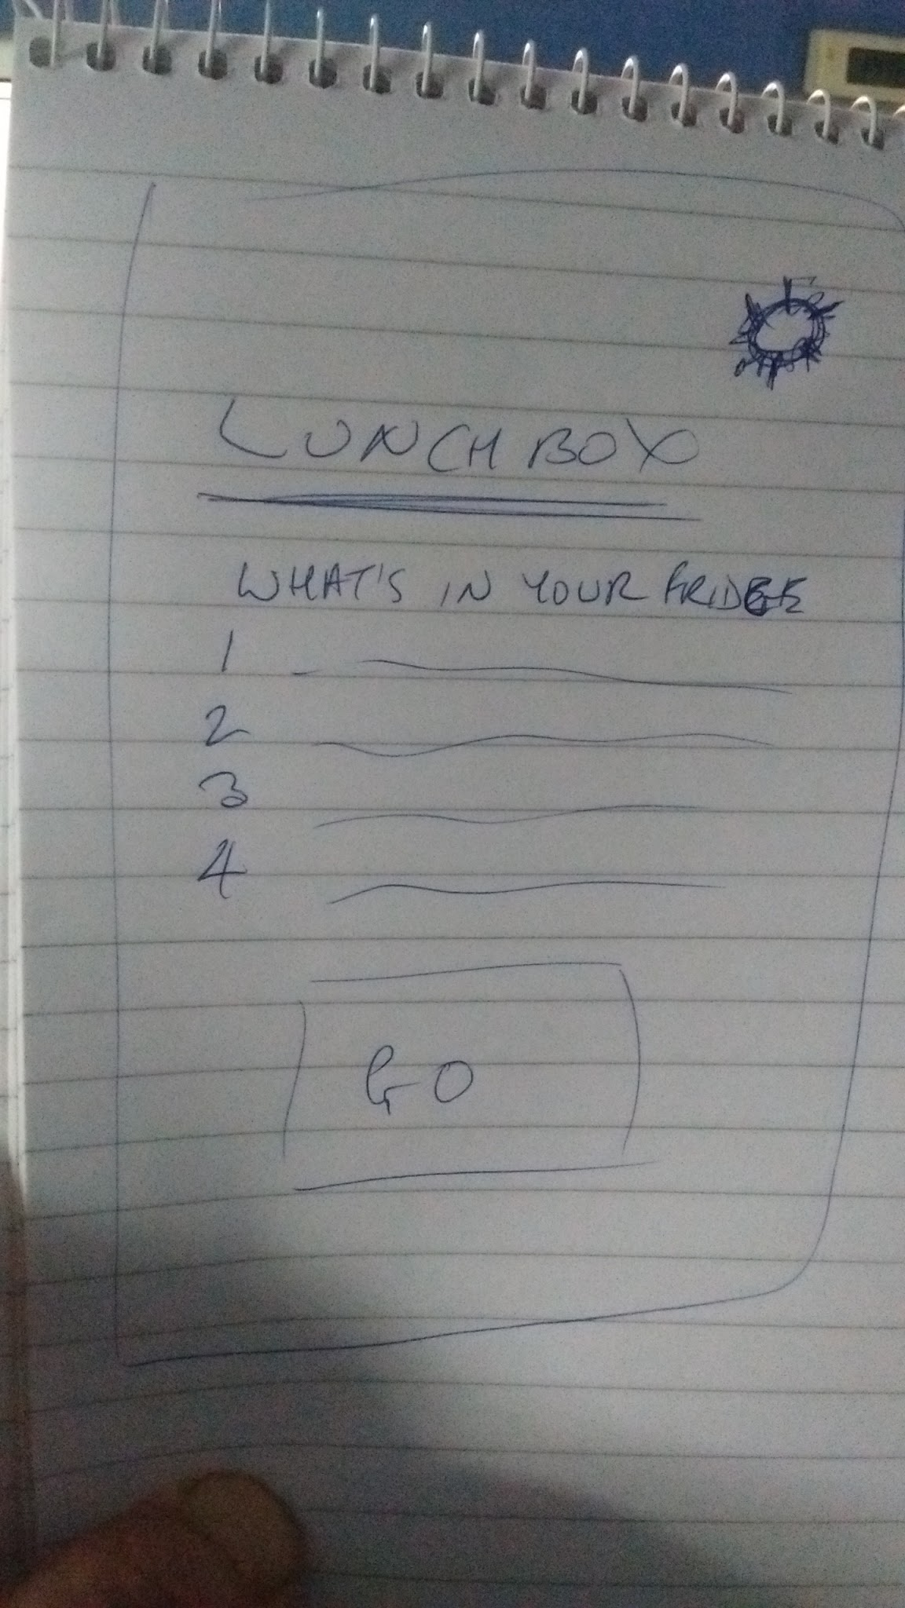
The process
The Initial sketches were simple, basic, and uncluttered.
A Bic biro and a reporter’s pad.
A simple idea.
It’s an ethos, an idea, and an execution that carried through to the delivered prototype.
Simplicity.

Slide 4
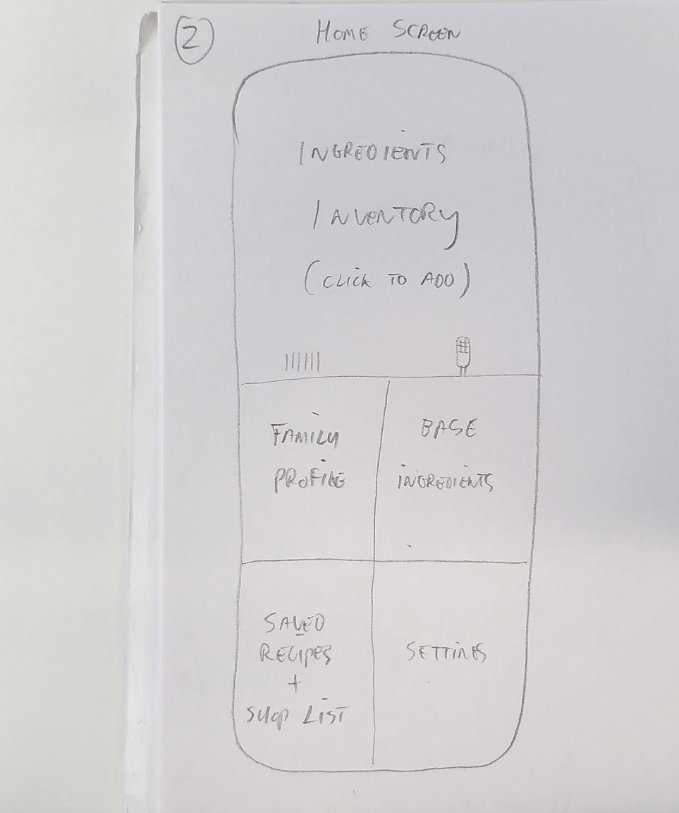
StoryBoard Evolution
We added in more features. In line with the freeform, open-ended, and uninhibited philosophy we approached brainstorming with, the storyboards became more complex.
Feature rich.
Not cluttered. But. Well. It’s easier to cut what you have, rather than invent what you don’t.
We used our storyboarding as a rapidly iterative process, evolving towards function and simplicity.

Slide 5
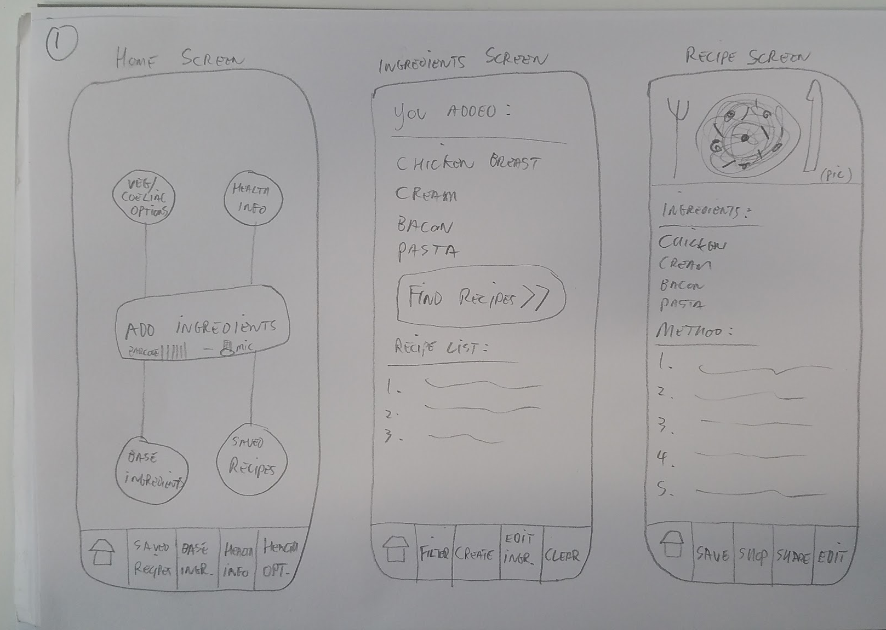
Storyboard evolution
As the brainstorming stormed and the feature wish list grew, so did the complexity of the interface.
The app wasn’t cluttered. But there was a tension beginning to manifest between features and minimalist interface.
Something the team noticed, and that formed the heart of the team discussion.

Slide 6
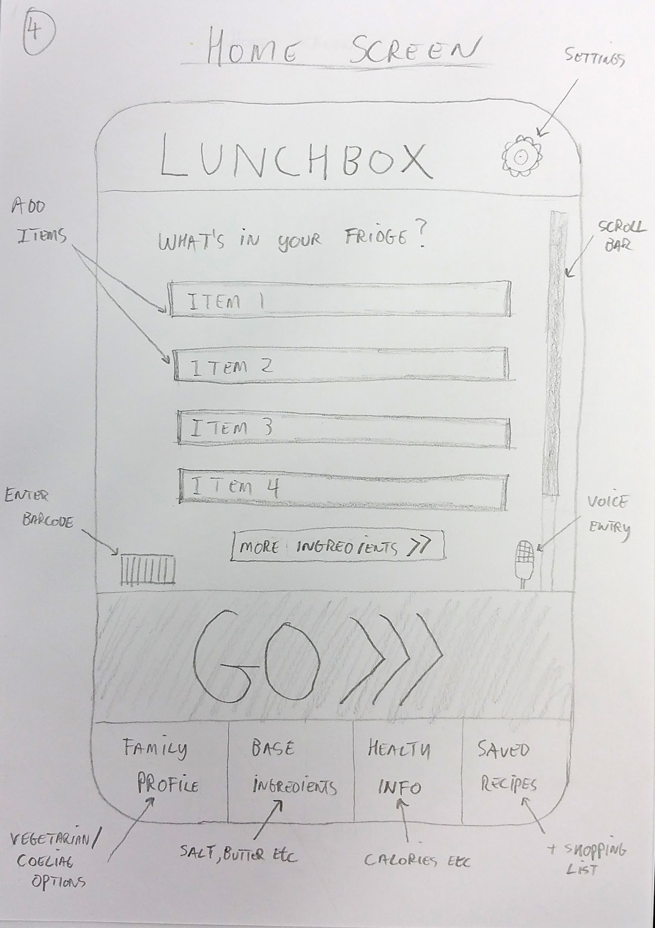
Almost There...
We began reconciling the need for simplicity with a desire for key and core functionality.
Focusing on simplicity allowed us to refine, define, and select what we really considered core.
Each rendering of the interface allowed us to focus more clearly on balancing the opposing needs of the seemingly non negotiable. Function and simplicity.

Slide 7
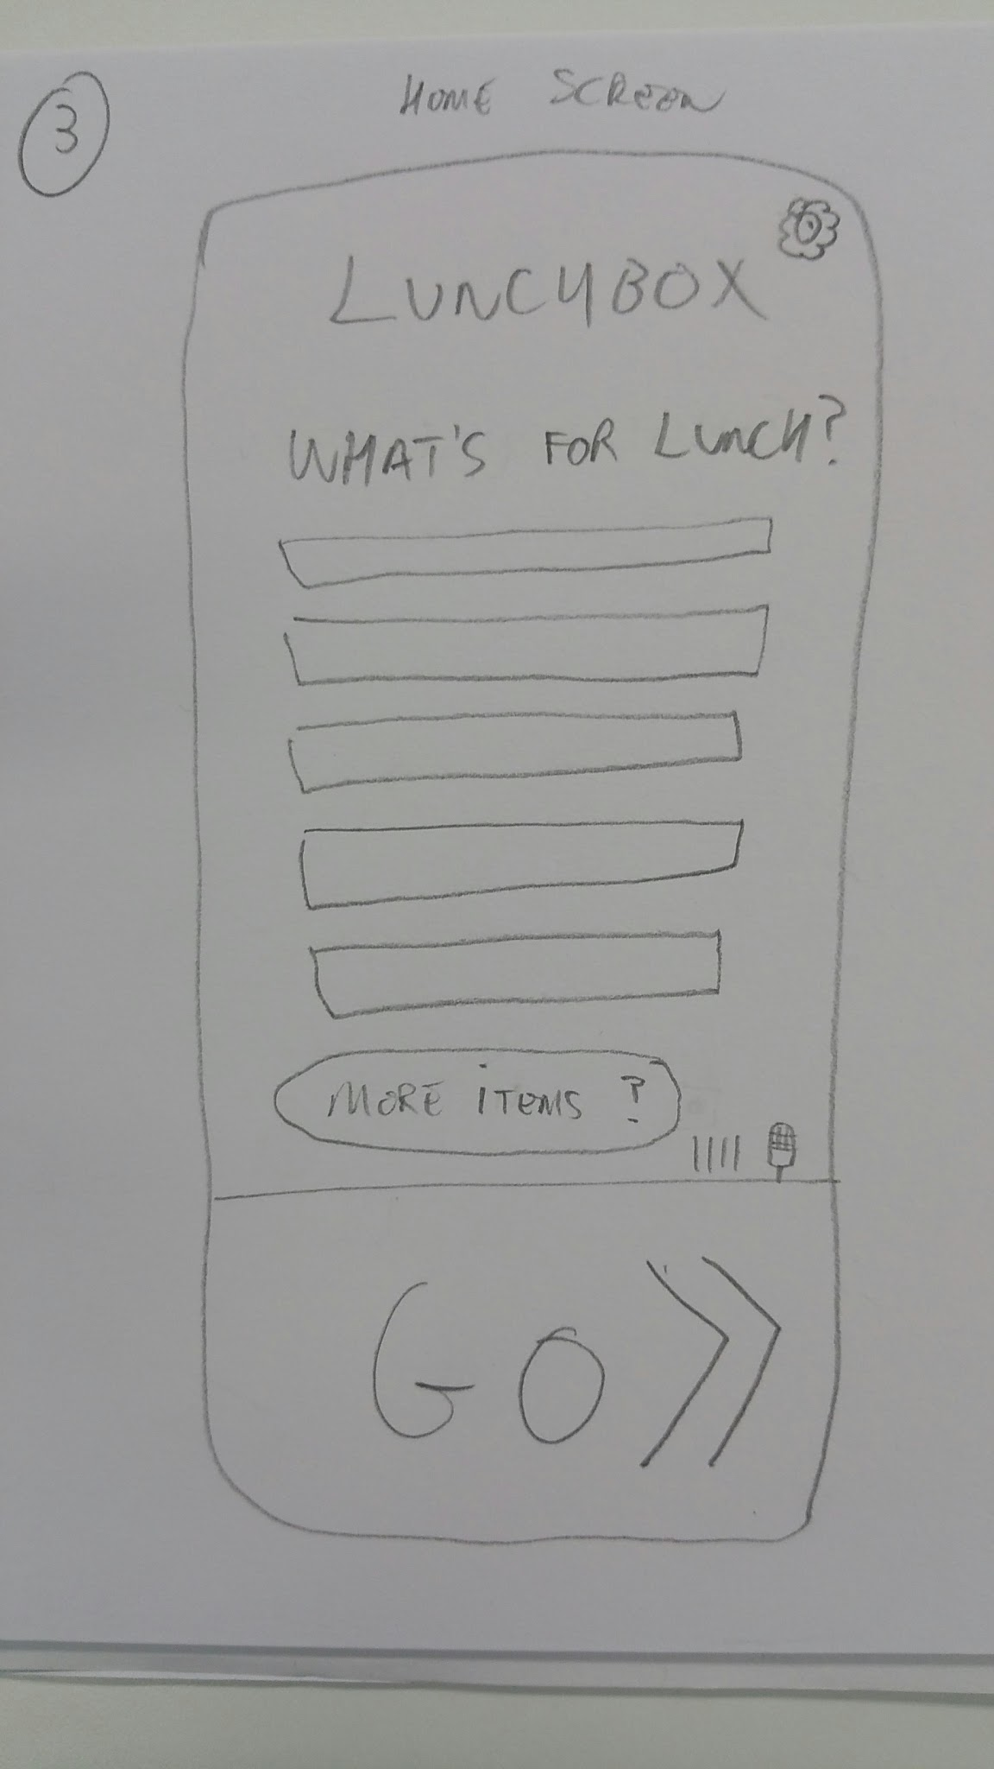
Resolution
We refocused. We folded functions into each other, or found workarounds to remove buttons.
We shelved non core functions in the light of our nascent sense of what our MVP and Critical Success Factors were.
And we resolved towards simplicity.
The interface is simple. Uncluttered. With only space for what needs to be there.

Slide 8
What we learned
And how we learned it

Slide 9
What we learned
It’s probably easier to edit down from too many features than build up from too few.
The Minimum Viable Product has Minimum in it for a reason.
Resolving your design towards simplicity forces you to be ruthless in your prioritisation. Simplicity forces you to focus on the essential.
A picture isn’t worth a thousand words. It’s worth the ten words you really need to hear.
Visual representations are the catalysts for your critical conversation. You can see what’s right and wrong with something in seconds and that can shape the conversation. It can take days or weeks to have the same experience with a feature list.

Slide 10
How we learned it
The team Designer, Leon, rapidly responded to team suggestions, demands, whims and flights of fancy.
We had a rapidly iterative process where we were able to push forward the conversation using the storyboarding as an engine.
This process was based on a rich brainstorming basis, and the team exchanged ideas, critiques, doubts, confidence and knowledge extensively as a part of the conversation.

